Slide 1


AI Chatbot Tensorflow Seq2seq MOdel
Deep Learning
Guided By:
Abonia Sojasingarayar Yacine Aslima
M2-Artificial Intelligence-IA school Prof. AI-IA School
May,2020

Slide 2
Credits and Motivation
Siraj Raval - Founder of School of AI
Andrew NG - Founder and CEO of Landing AI & Founder of deeplearning.ai
Tensorflow Community
Cornell University - For dataset

Slide 3




Table of Content:
Introduction
Data collection and preprocessing
Building the model:
LSTM Architecture
Encoder Decoder model
Word embedding for encoder and decoder
Attention mechanism
GreedyEmbedding helper
Optimization
Evaluation metrics comparision
Testing the model
Model Parameters optimization
Future Improvement
Conclusion
References

Slide 4
Introduction:
Conversational AI Chatbot is a language recognition system able to maintain a conversation with a user using a question/answer protocol.
We are going to focus on the textual models.
Many major tech companies are using a virtual assistant or chat agent to ill the needs of customers.
Some of them include Google’s Google Assistant, Microsoft’s Cortana and Amazon’s Alexa.

Slide 5

A sequence is an ordered list of symbols. For Ex:
A sequence of webpages visited by a user, ordered by the time of access.
A sequence of words or characters typed on a cellphone by a user, or in a text such as a book.
A sequence of products bought by a customer in a retail store
A sequence of proteins in bioinformatics
A sequence of symptoms observed on a patient at a hospital
Note : we consider that a sequence is a list of symbols and do not contain numeric values. A sequence of numeric values is usually called a time-series rather than a sequence, and the task of predicting a time-series is called time-series forecasting.
The task of sequence prediction consists of predicting the next symbol of a sequence based on the previously observed symbols. For example, if a user has visited some webpages A, B, C, in that order, one may want to predict what is the next webpage that will be visited by that user to prefetch the webpage.
Source: http://data-mining.philippe-fournier-viger.com

Slide 6
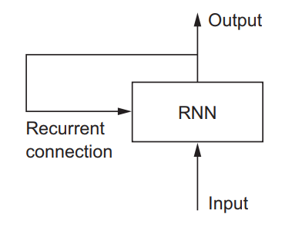
RNN:
Recurrent Neural Networks, or RNNs, were designed to work with sequence prediction problems.
Recurrent means the output at the current time step becomes the input to the next time step. At each element of the sequence, the model considers not just the current input, but what it remembers about the preceding elements.
Why RNN?
To maintain word order
To share parameters across the sequence
Source: https://www.manning.com/books/deep-learning-with-python

Slide 7
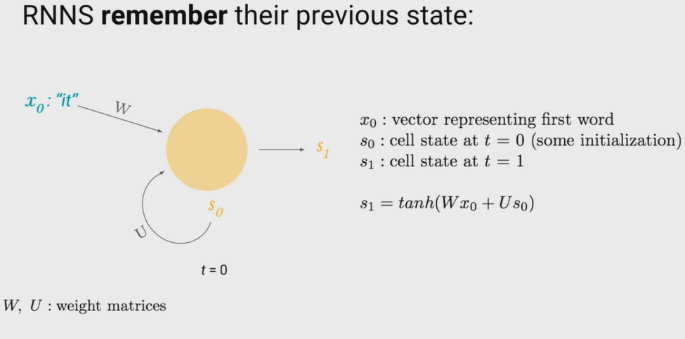
Source: MITCBMM-Harini Suresh and Nicholas Locascio

Slide 8
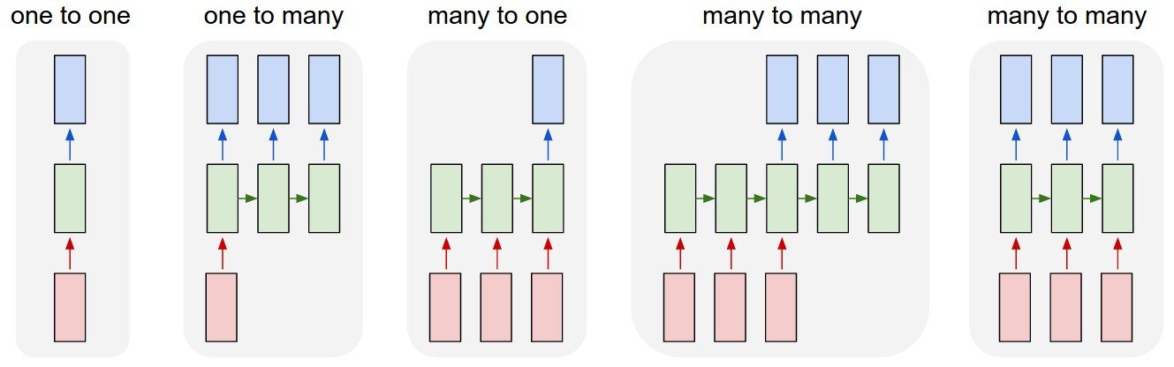
Types of RNN:
One-to-Many: An observation as input mapped to a sequence with multiple steps as an output.ex:image(i/p) description (o/p)
Many-to-One: A sequence of multiple steps as input mapped to class or quantity prediction.ex:Language classification
Many-to-Many: A sequence of multiple steps as input mapped to a sequence with multiple steps as output.ex:Machine translation

Slide 9
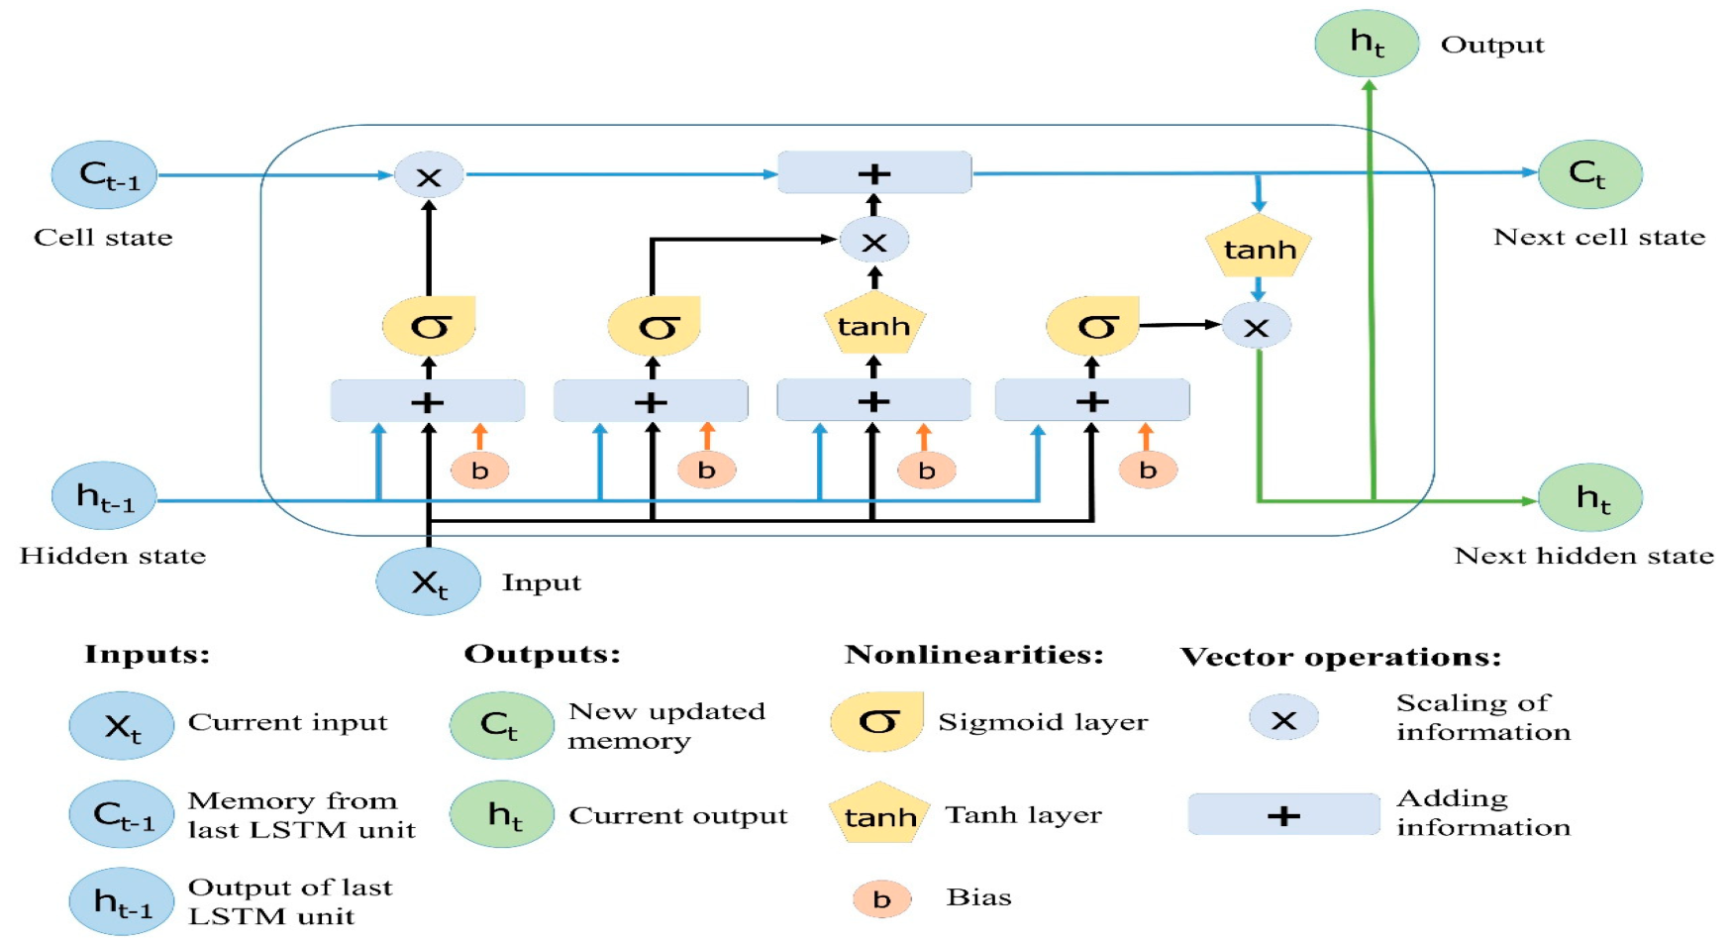
LSTM:
Long Short-Term Memory (LSTM) networks are a type of recurrent neural network capable of learning order dependence(long-term dependencies) in sequence prediction problems.
This is a behavior required in complex problem domains like machine translation, speech recognition, and more.
Image Source: https://colah.github.io

Slide 10
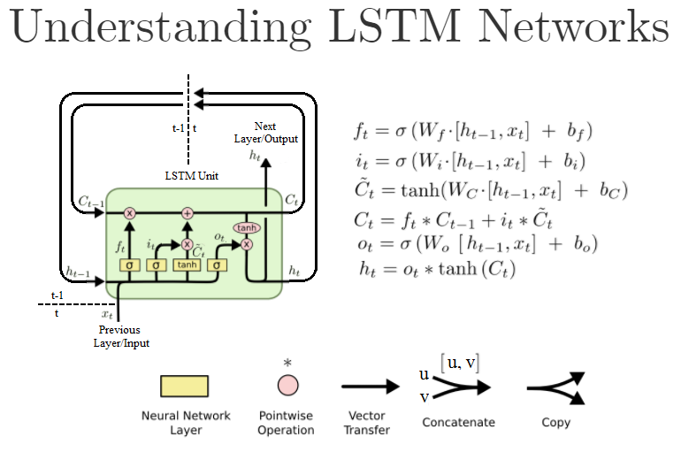
Image Source: https://colah.github.io

Slide 11
Seq2Seq LSTMs or RNN Encoder-Decoders:
An “encoder” RNN reads the source sentence and transforms it into a rich fixed-length vector representation, which in turn in used as the initial hidden state of a “decoder” RNN that generates the target sentence. Here, we propose to follow this elegant recipe, replacing the encoder RNN by a deep convolution neural network (CNN). … it is natural to use a CNN as an image “encoder”, by first pre-training it for an image classification task and using the last hidden layer as an input to the RNN decoder that generates sentences.
Source: — Oriol Vinyals, et al., Show and Tell: A Neural Image Caption Generator, 2014
… an RNN Encoder–Decoder, consists of two recurrent neural networks (RNN) that act as an encoder and a decoder pair. The encoder maps a variable-length source sequence to a fixed-length vector, and the decoder maps the vector representation back to a variable-length target sequence.
Source: — Kyunghyun Cho, et al., Learning Phrase Representations using RNN Encoder-Decoder for Statistical Machine Translation, 2014

Slide 12
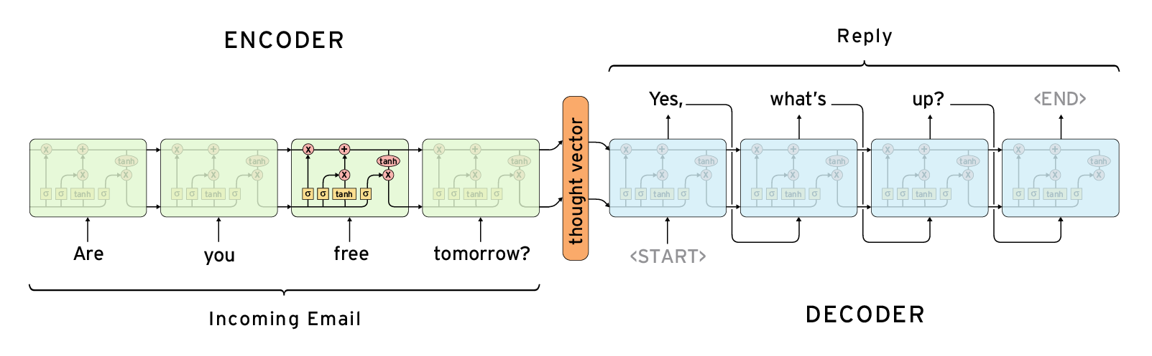
Example architecture of Seq2Seq LSTMs or RNN Encoder-Decoders
Source: http://www.wildml.com/2016/04/deep-learning-for-chatbots-part-1-introduction/

Slide 13
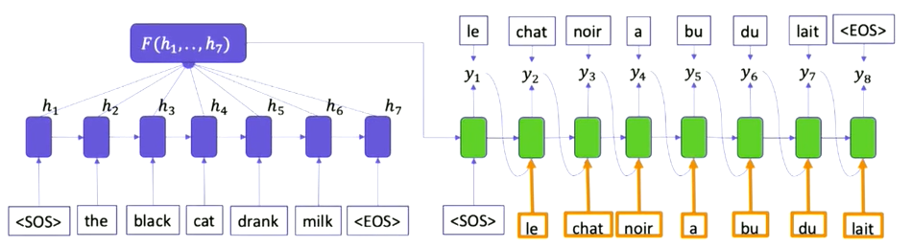
Machine Translation Example:
Source: https://confengine.com/odsc-india-2019/proposal/10176/sequence-to-sequence-learning-with-encoder-decoder-neural-network-models

Slide 14
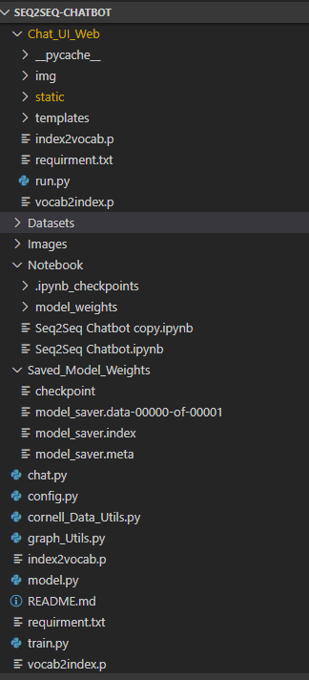
Undersatanding Working Directory:

Slide 15
Dataset : Cornell Movie Dialogs Corpus
Description:
This corpus contains a large metadata-rich collection of fictional conversations extracted from raw movie scripts.
Link to download dataset : https://www.cs.cornell.edu/~cristian/Cornell_Movie-Dialogs_Corpus.html
https://www.kaggle.com/rajathmc/cornell-moviedialog-corpus
220,579 conversational exchanges between 10,292 pairs of movie characters
Involves 9,035 characters from 617 movies
In total 304,713 utterances
Movie metadata included:
Genres
Release year
IMDB rating
Number of IMDB votes
Character metadata included:
Gender (for 3,774 characters)
Position on movie credits (3,321 characters)
README.txt (included) for details

Slide 16
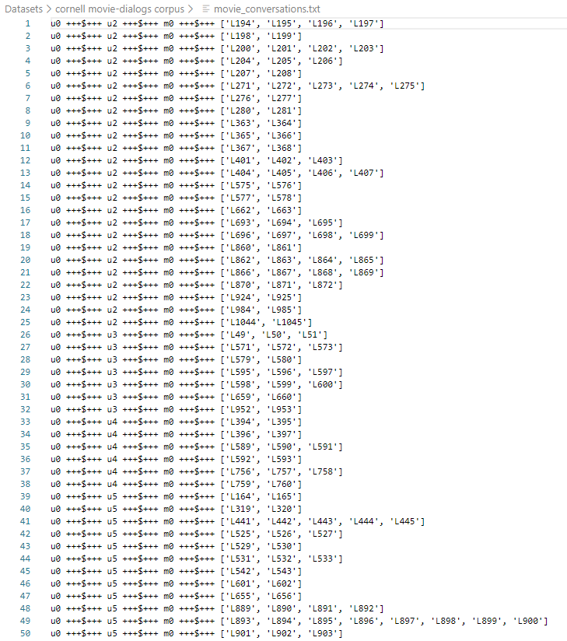
Movie Conversation File:
First 50 lines of movie_conversations.txt:

Slide 17
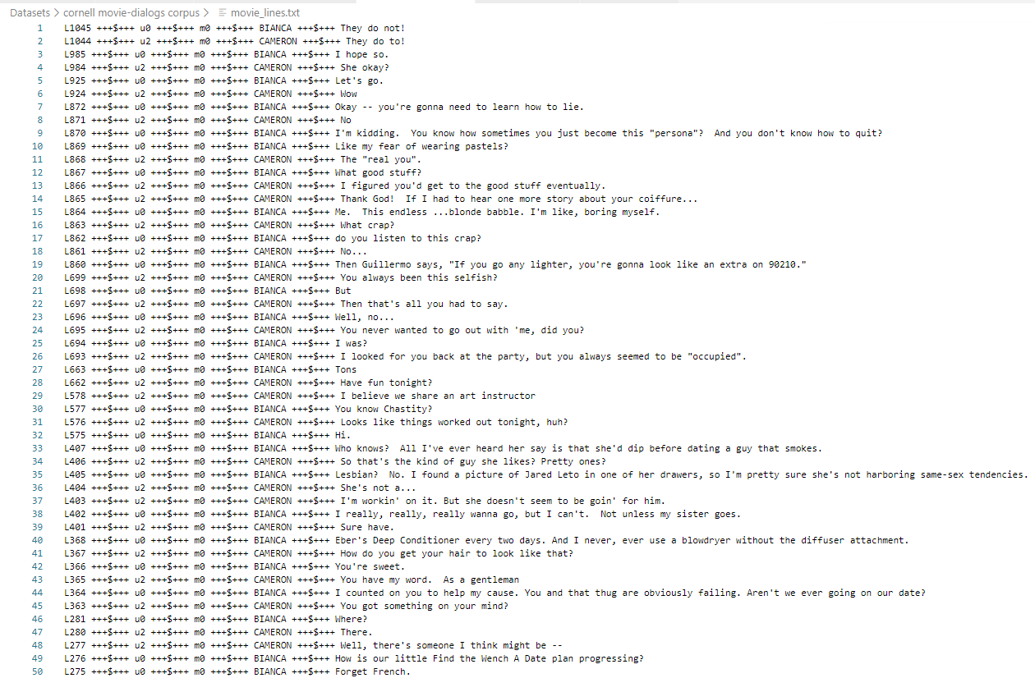
Movie Lines File:
First 50 lines of movie_lines.txt:

Slide 18


Understanding Single Conversation:
Take first conversation in movie_conversations.txt
i.e ['L194', 'L195', 'L196', 'L197']
Corresponding movie lines(index and line) for the above conversation:

Slide 19
Preprocessing I:
Step 1:
Read from 'movie_conversations.txt'
Create a list of [list of line_id's]
Output Ex: ['L194', 'L195', 'L196', 'L197']
Step 2:
Read from 'movie-lines.txt'
Create a dictionary with ( key = line_id, value = text )
Ex:
They do not!
They do to!
I hope so.
She okay?
Let's go.
Wow
Okay -- you're gonna need to learn how to lie.
No
I'm kidding. You know how sometimes you just become this "persona"? And you don't know how to quit?
Like my fear of wearing pastels?
The "real you".
What good stuff?
I figured you'd get to the good stuff eventually.

Slide 20
Preprocessing II:
Step 3:
Get lists of all conversations as Questions and Answers
[questions]
[answers]
Question and answers are come from same conversation.As because there will be a question with the response.
Ex: For our first conversation
Q Can we make this quick? Roxanne Korrine and Andrew Barrett are having an incredibly horrendous public break- up on the quad. Again.
A Well, I thought we'd start with pronunciation, if that's okay with you.
Q Well, I thought we'd start with pronunciation, if that's okay with you.
A Not the hacking and gagging and spitting part. Please.
Q Not the hacking and gagging and spitting part. Please.
A Okay... then how 'bout we try out some French cuisine. Saturday? Night?
Step 4:
Clean Text:
Text to lowercase
Replacing certain words as follow:
Ex:
text = re.sub(r"i'm", "i am", text)
text = re.sub(r"he's", "he is", text)
text = re.sub(r"she's", "she is", text)
text = re.sub(r"it's", "it is", text)
text = re.sub(r"that's", "that is", text)
text = re.sub(r"\'ll", " will", text)
text = re.sub(r"\'ve", " have", text)
text = re.sub(r"\'re", " are", text)
text = re.sub(r"\'re", " are", text)
text = re.sub(r"can't", "cannot", text)

Slide 21
Preprocessing III:
Step 5:
Filter out the Questions and Answers that are too short/long
Minimum&Maximum length are 2&5
Step 6:
Get each word and its count from filtered questions and answers in vocab dictionary
Get each word and its count from filtered questions and answers in Question and Answer vocab dictionary
Step 7:
Create vocabulary index with total number of words appear more than 2 times in vocab dictionary
6281 words which appear more appear more than 2 times
Step 8:
For each codes(<EOS>,<PAD>,<UNK><GO>) ,increment vocabulary index to 1 for each existing code
Same for question and answer vocab.
Now vocab index will be 6285
Step 9:
Create index vocabulary from vocabulary index dictionary
index vocabulary dict_items([(0, 'what'), (1, 'good'), (2, 'stuff'), (3, 'she'), (4, 'okay'), (5, 'they'),......
......., (6283, '<PAD>'), (6284, '<EOS>'), (6285, '<UNK>'), (6286, '<GO>')])
Step 10:
Add EOS tag at the end of each answer
Ex: the real you → the real you <EOS>
Step 11:
Again filter out words in by comparing words in filtered question and words in vocabulary index
Do the same for filtered answer

Slide 22
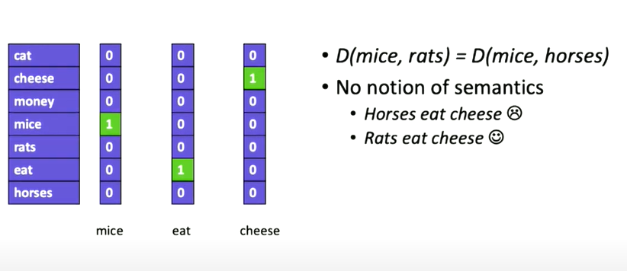
Word Representation: One-hot
No semantic meaning
Source: https://confengine.com/odsc-india-2019/proposal/10176/sequence-to-sequence-learning-with-encoder-decoder-neural-network-models

Slide 23
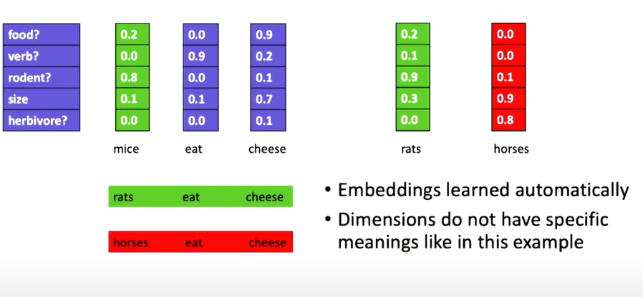
Word Embeddings
Enable semantics.
Measures distance between words in semantic space
Source: https://confengine.com/odsc-india-2019/proposal/10176/sequence-to-sequence-learning-with-encoder-decoder-neural-network-models

Slide 24
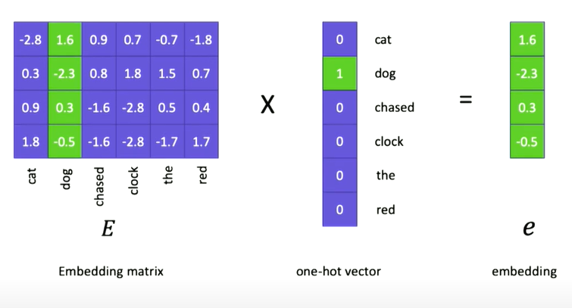
From one-hot to Embeddings
Embadding matrix is a learned parameters of the model.Embedding vector for the particular word
Source: https://confengine.com/odsc-india-2019/proposal/10176/sequence-to-sequence-learning-with-encoder-decoder-neural-network-models

Slide 25
TensorBoard :
TensorBoard is a tool for providing the measurements and visualizations needed during the machine learning workflow. It enables tracking experiment metrics like loss and accuracy, visualizing the model graph, projecting embeddings to a lower dimensional space, and much more.
Here we used tensorboard for :
Projection (T-sne,PCA): To visualize word embedding in low dimensional space
Graph:TensorBoard’s Graphs dashboard is a powerful tool for examining our TensorFlow model. we can quickly view a conceptual graph of our model’s structure and ensure it matches our intended design. We can also view a op-level graph to understand how TensorFlow understands our program.
Scalar:To visualize plot of accuracy,loss during training and validation
Note:A review and screenshots are provided in upcoming slide

Slide 26
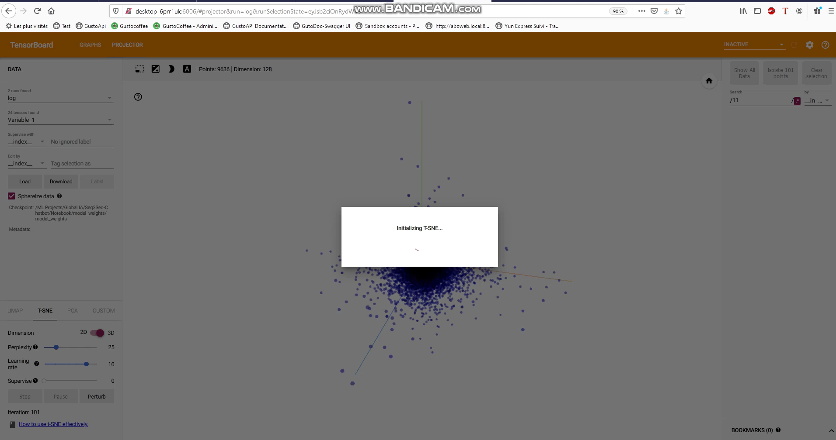
Visualizing Word Embedding using Projectior in Tensorboard

Slide 27
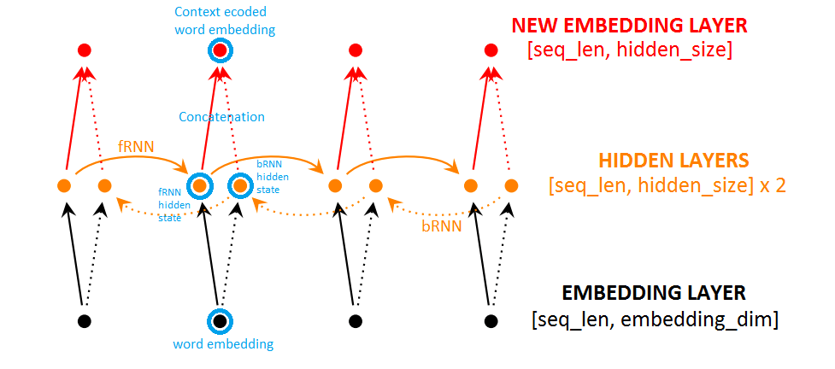
BidirectionalRNN
Bidirectional Recurrent Neural Networks (BRNN) connect two hidden layers of opposite directions to the same output. With this form of generative deep learning, the output layer can get information from past (backwards) and future (forward) states simultaneously.
Source: https://chaitjo.github.io/context-embeddings/

Slide 28
Attention Mechanism:
Freeing the encoder-decoder architecture from the fixed-length internal representation.
Achieved by keeping the intermediate outputs from the encoder LSTM from each step of the input sequence and training the model to learn to pay selective attention to these inputs and relate them to items in the output sequence.
Each time the proposed model generates a word in a translation, it (soft-)searches for a set of positions in a source sentence where the most relevant information is concentrated. The model then predicts a target word based on the context vectors associated with these source positions and all the previous generated target words.
… it encodes the input sentence into a sequence of vectors and chooses a subset of these vectors adaptively while decoding the translation. This frees a neural translation model from having to squash all the information of a source sentence, regardless of its length, into a fixed-length vector.
Source: — Dzmitry Bahdanau, et al., Neural machine translation by jointly learning to align and translate, 2015

Slide 29
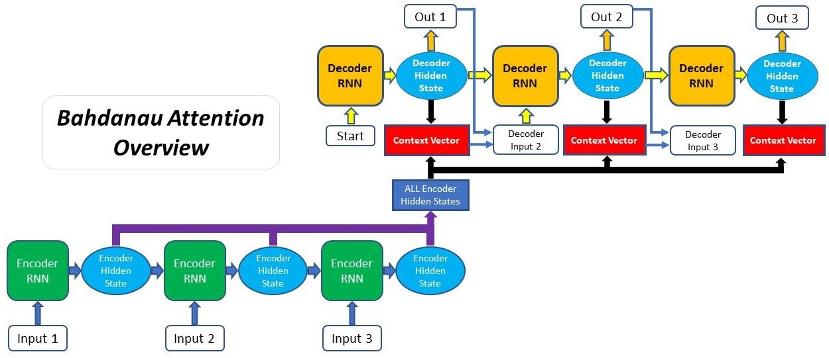
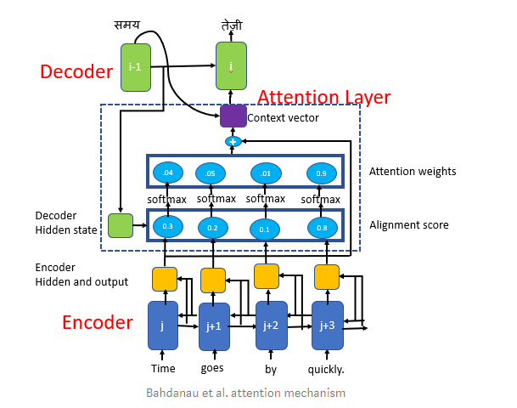
Bahdanau Attention:Additive Attention
Aligning the decoder with the relevant input sentences and implementing Attention.
The proposed approach provides an intuitive way to inspect the (soft-)alignment between the words in a generated translation and those in a source sentence. This is done by visualizing the annotation weights… Each row of a matrix in each plot indicates the weights associated with the annotations. From this we see which positions in the source sentence were considered more important when generating the target word
Source: https://blog.floydhub.com/content/images/2019/09/Slide38.JPG

Slide 30
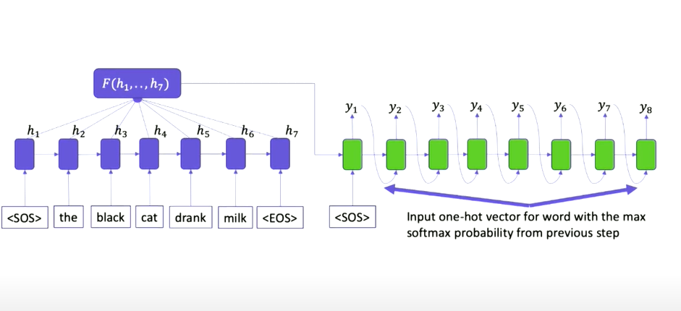
Encoder-Decoder model(Greedy Inference):
Greedy search that selects the most likely word at each step in the output sequence OR Return the words which have maximum probability at the time
Source: https://confengine.com/odsc-india-2019/proposal/10176/sequence-to-sequence-learning-with-encoder-decoder-neural-network-models

Slide 31
Optimizer:Adam Optimizer
The method computes individual adaptive learning rates for different parameters.
Adam as combining the advantages of two other extensions of stochastic gradient descent.
Adaptive Gradient Algorithm (AdaGrad) that maintains a per-parameter learning rate that improves performance on problems with sparse gradients (e.g. natural language and computer vision problems).
Root Mean Square Propagation (RMSProp) that also maintains per-parameter learning rates that are adapted based on the average of recent magnitudes of the gradients for the weight (e.g. how quickly it is changing). This means the algorithm does well on online and non-stationary problems (e.g. noisy).
Instead of adapting the parameter learning rates based on the average first moment (the mean) as in RMSProp, Adam also makes use of the average of the second moments of the gradients (the uncentered variance).

Slide 32
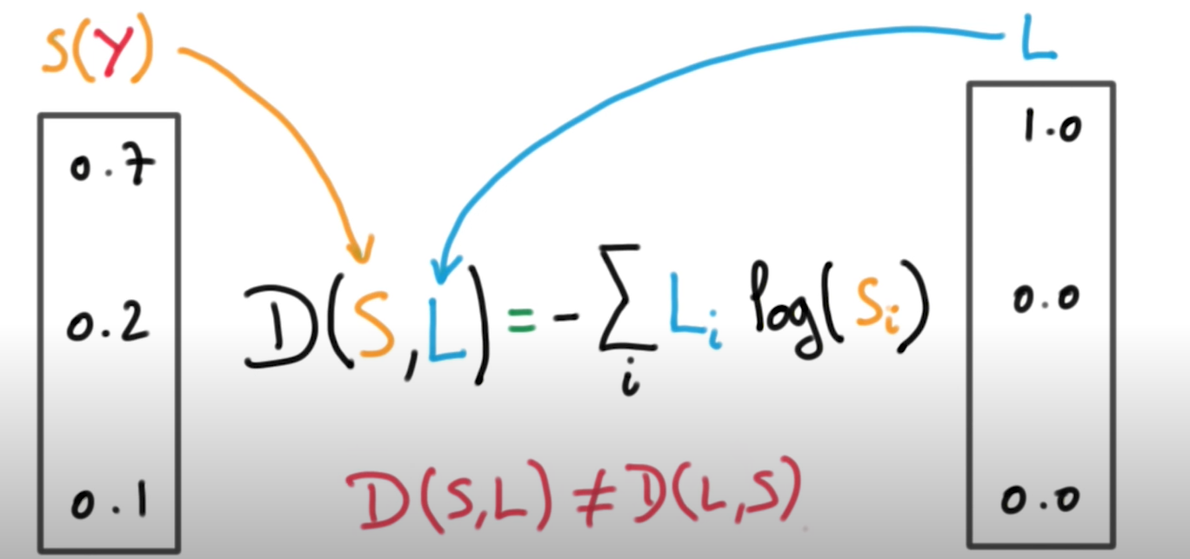
Loss:
Weighted cross-entropy loss for a sequence of logits.
Source: https://www.udacity.com/course/ud730

Slide 33
Configuration:
Config 1
Config 2
batch_size = 128
rnn_size = 128
embed_size = 128
learning_rate = 0.001
keep_prob = 0.75
epochs = 500
model_dir = 'saved_model_weights'
save_path = 'model_saver'
min_learning_rate = 0.0001
learning_rate_decay = 0.9
batch_size = 512
rnn_size = 512
embed_size = 512
learning_rate = 0.001
keep_prob = 0.75
epochs = 80
model_dir = 'saved_model_weights'
save_path = 'model_saver'
min_learning_rate = 0.0001
learning_rate_decay = 0.9

Slide 34
Execution Time:
For Config 1:
For each epochs it took nearly 2 to 3 mins as we do have 500 epochs it took nearly 1000 mins that’s 16.5 hours in local machine(CPU).
For Config 1:
For each epochs it took nearly 8 to 9 mins as we do have 80 epochs it took nearly 900 mins that’s 15 hours in Google Colab Platform(CPU).

Slide 35
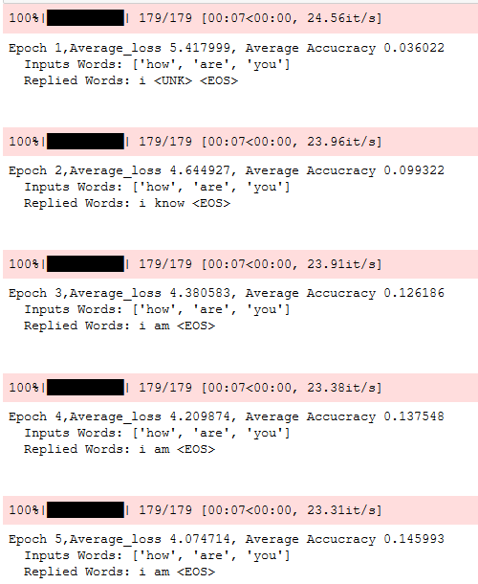
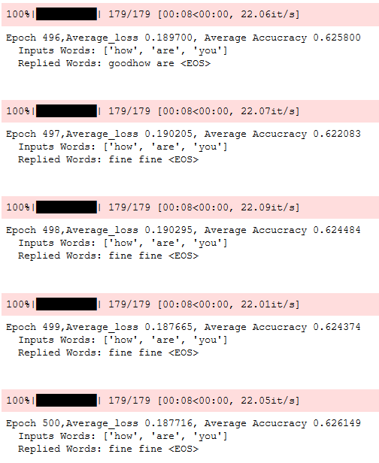
Config 1
Initial Epochs:
Final Epochs:

Slide 36
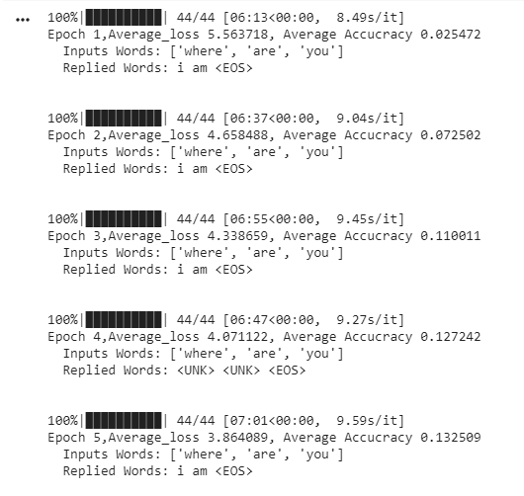
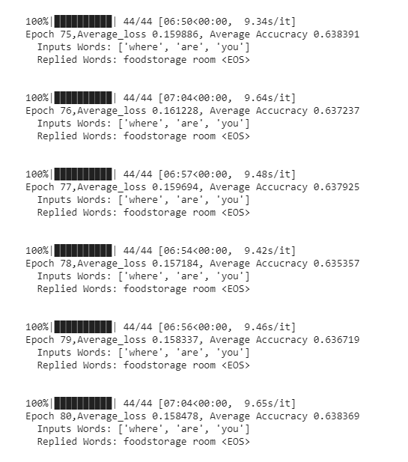
Config 2
Initial Epochs:
Final Epochs:

Slide 37
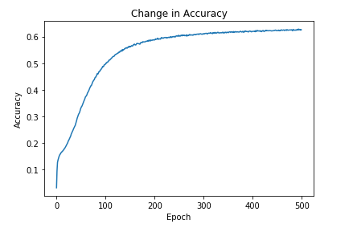
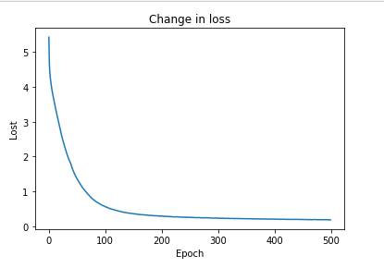
Config 1
Accuracy Plot:
Loss Plot:

Slide 38
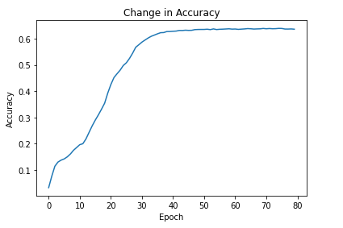
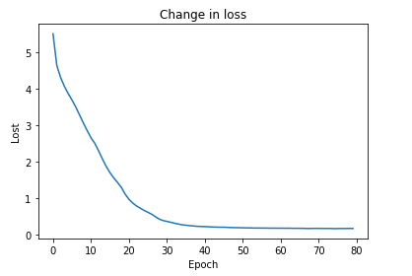
Config 2
Accuracy Plot:
Loss Plot:

Slide 39
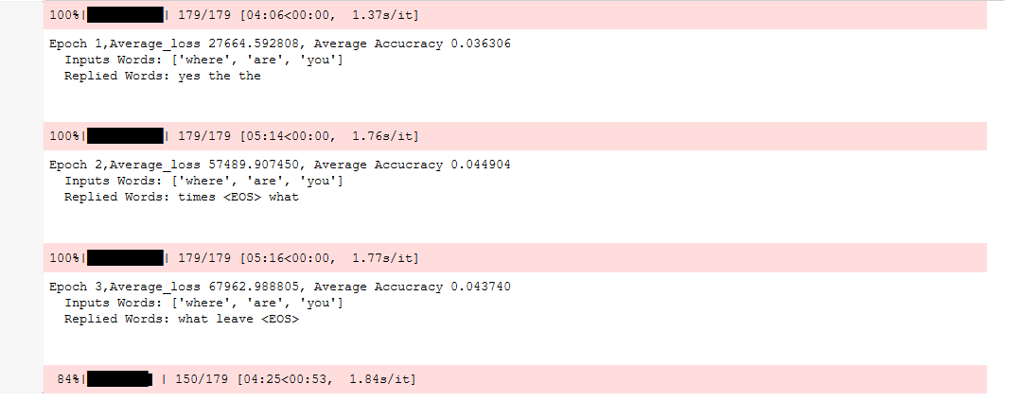
Initial Epochs with Learning Rate=0.5 in Config 1

Slide 40
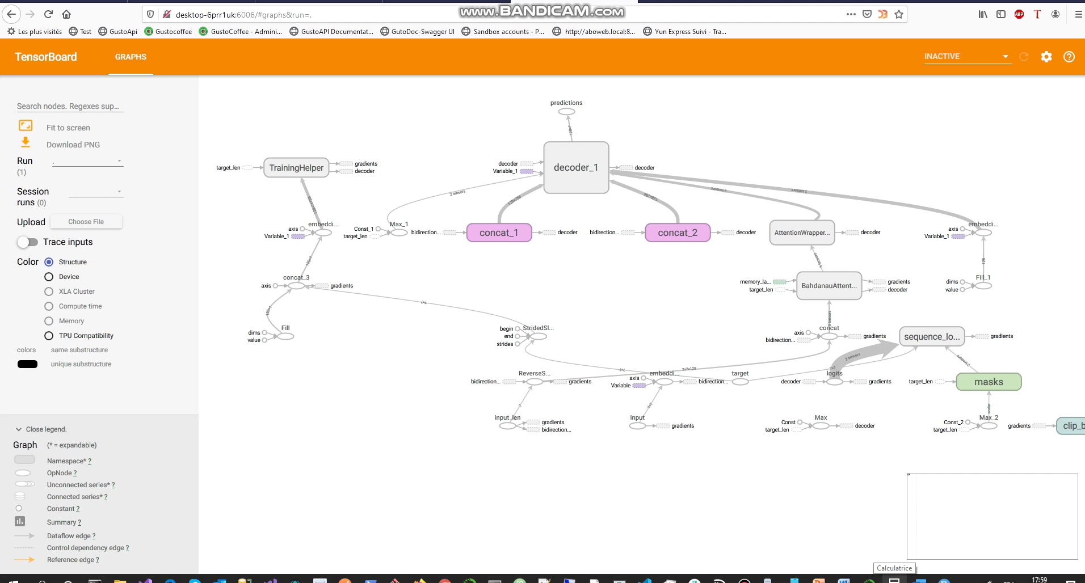

Slide 41
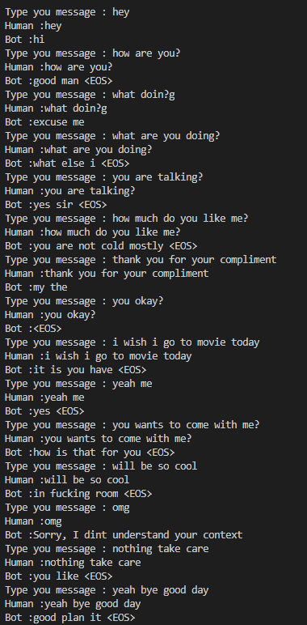
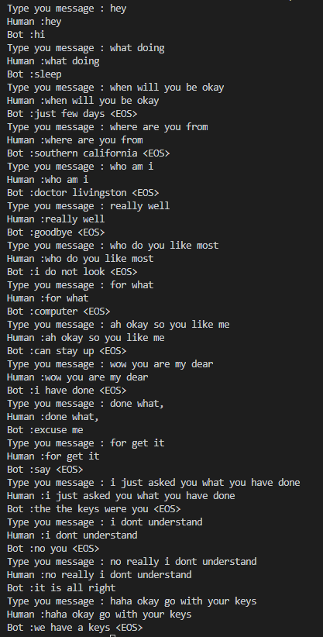
Test:

Slide 42
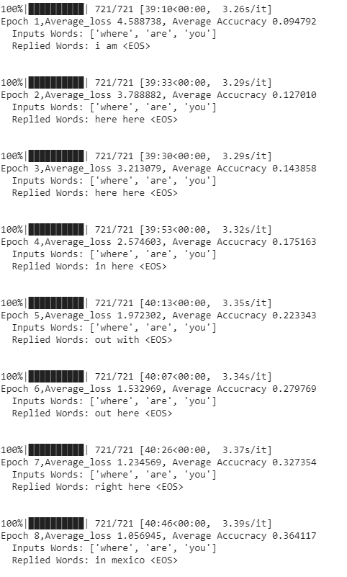
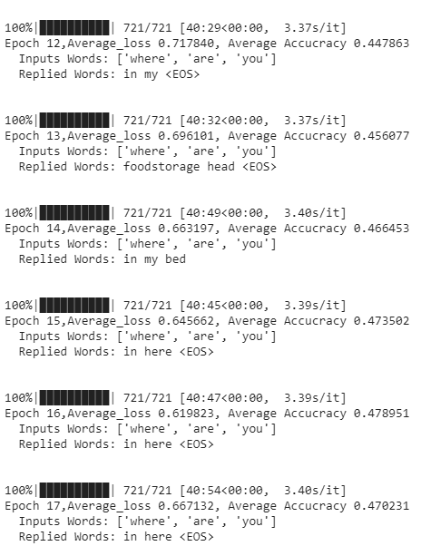
Config 3:

Slide 43
Web Interface
Flask app that provides a chat interface to the user, to interact with our seq2seq model.
The reply method in the code is called via an AJAX request from index.js.
It sends the text from user to our seq2seq model, which returns a reply.
The reply is passed to index.js and rendered as text in the chatbox.

Slide 44
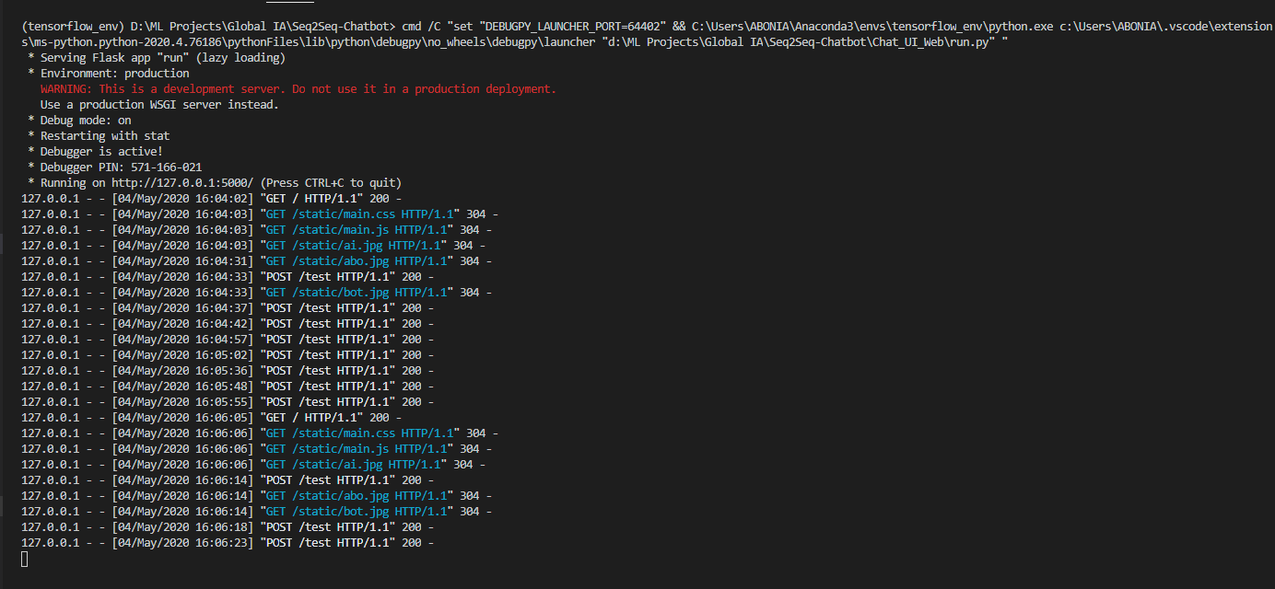
Run a web App with Flask:

Slide 45
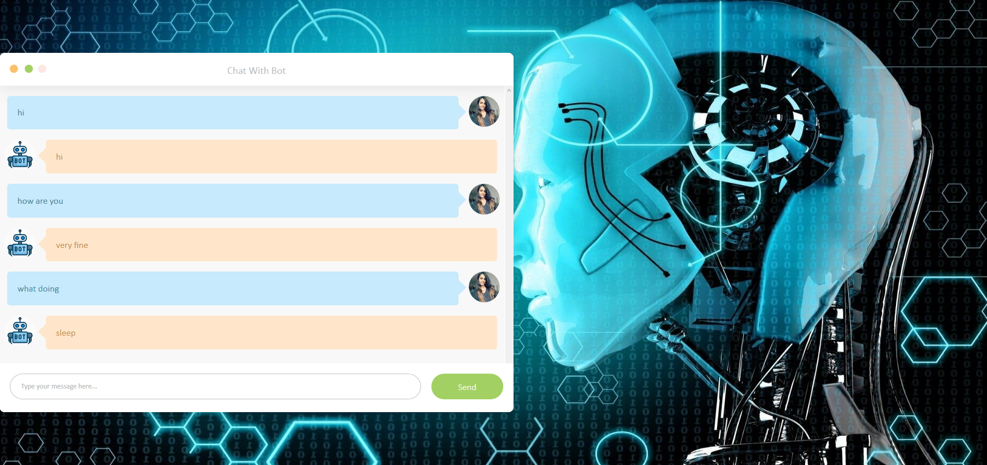
UI

Slide 46
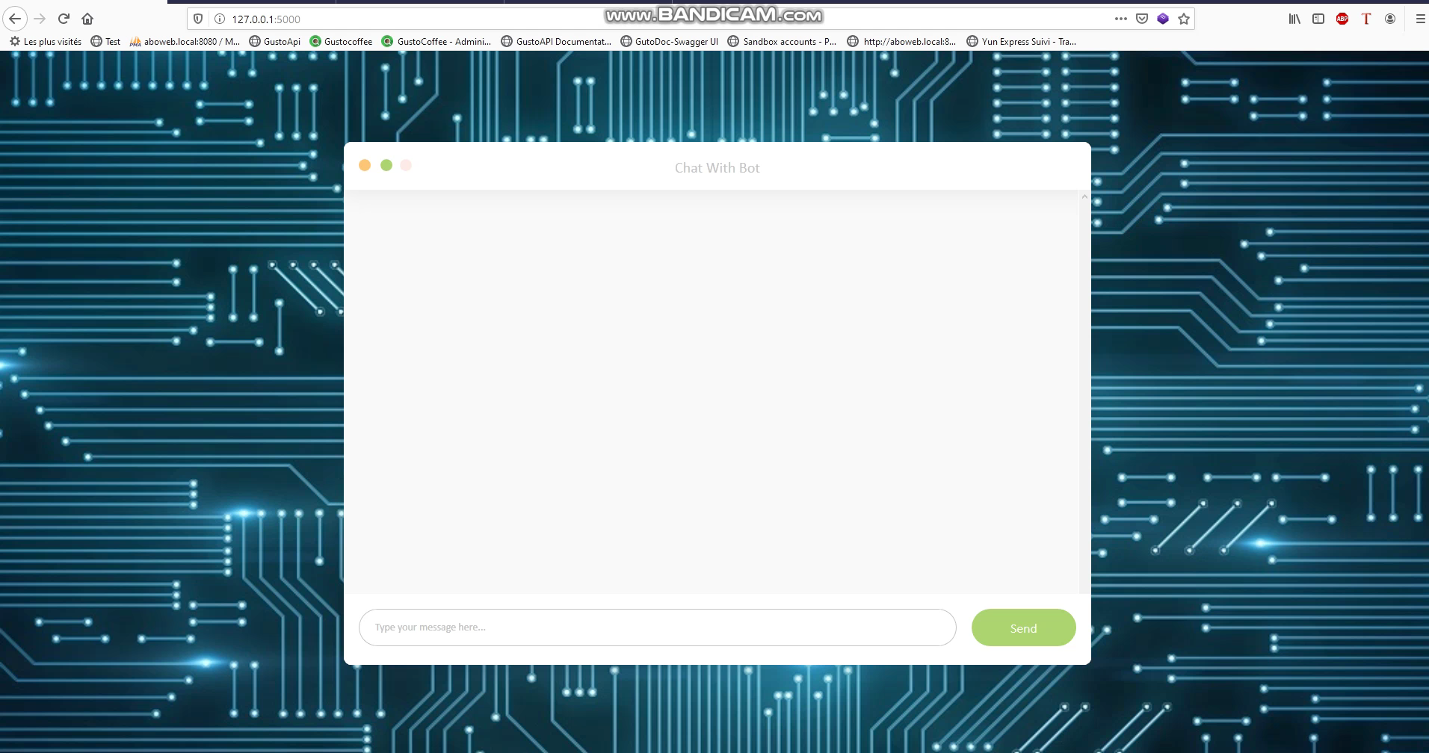

Slide 47
Future work:
Use attention mechanism like luong attention
Beam Search algorithm
Optimize based on other metrics
Embedding size and batch size to 1024(computationaly expensive)
Learning rate to 0.001 and dropout ratio to 0.5

Slide 48
Conclusion:
The training data on Cornell Movie Subtitle corpus produced a result that needs further improvement and more attention and speculation on training parameters.
Adding more quality data will further improve performance.
Also, the training model should be trained with other hyper-parameters and different datasets for further experimentation.

Slide 49
Other References:
https://machinelearningmastery.com/
https://ruder.io/word-embeddings-1/
Papers on seq2seq:
Learning Phrase Representations using RNN Encoder-Decoder for Statistical Machine Translation:https://arxiv.org/abs/1406.1078
Sequence to Sequence Learning with Neural Networks:https://arxiv.org/abs/1409.3215
Neural Machine Translation by Jointly Learning to Align and Translate:https://arxiv.org/abs/1409.0473
A Neural Conversational Model:https://arxiv.org/abs/1506.05869
Telegram Bots : An introduction for developers
Botfather
Mitsuku
Deep Learning for Chatbots : Introduction
Understanding LSTMS
Padding and Bucketing
On word embeddings - Part 1
On word embeddings - Part 2 (sampled softmax)
Attention and Memory in Deep Learning and NLP
easy_seq2seq
English-Frnch Translation in Tensorflow
Cornell Movie Dialog Corpus
Cornell Movie Dialog Corpus - Preprocessed
Flask : Quick Start

Slide 50
